Slide 1
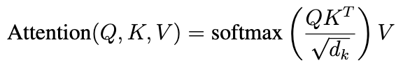
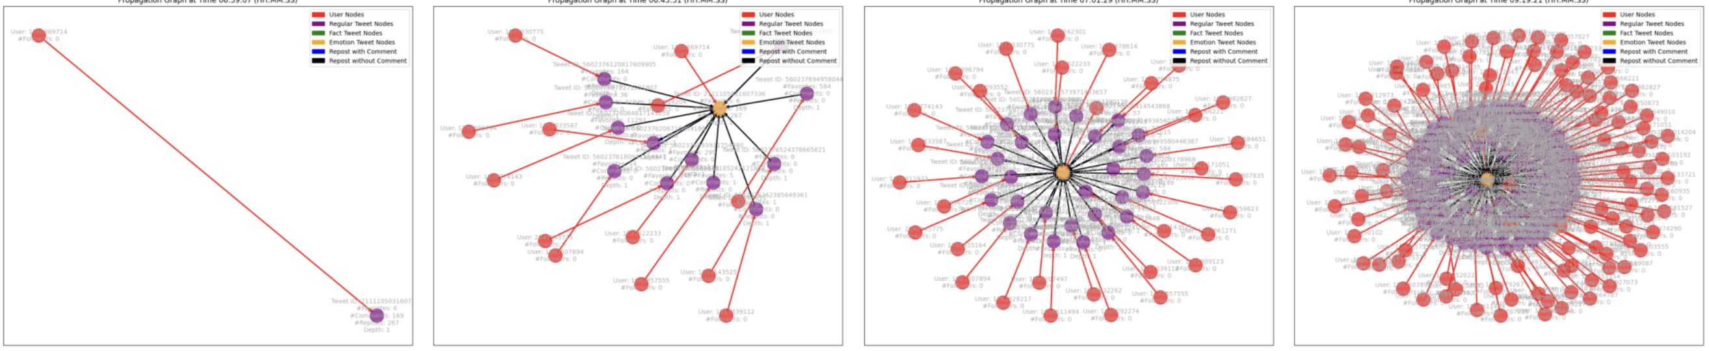
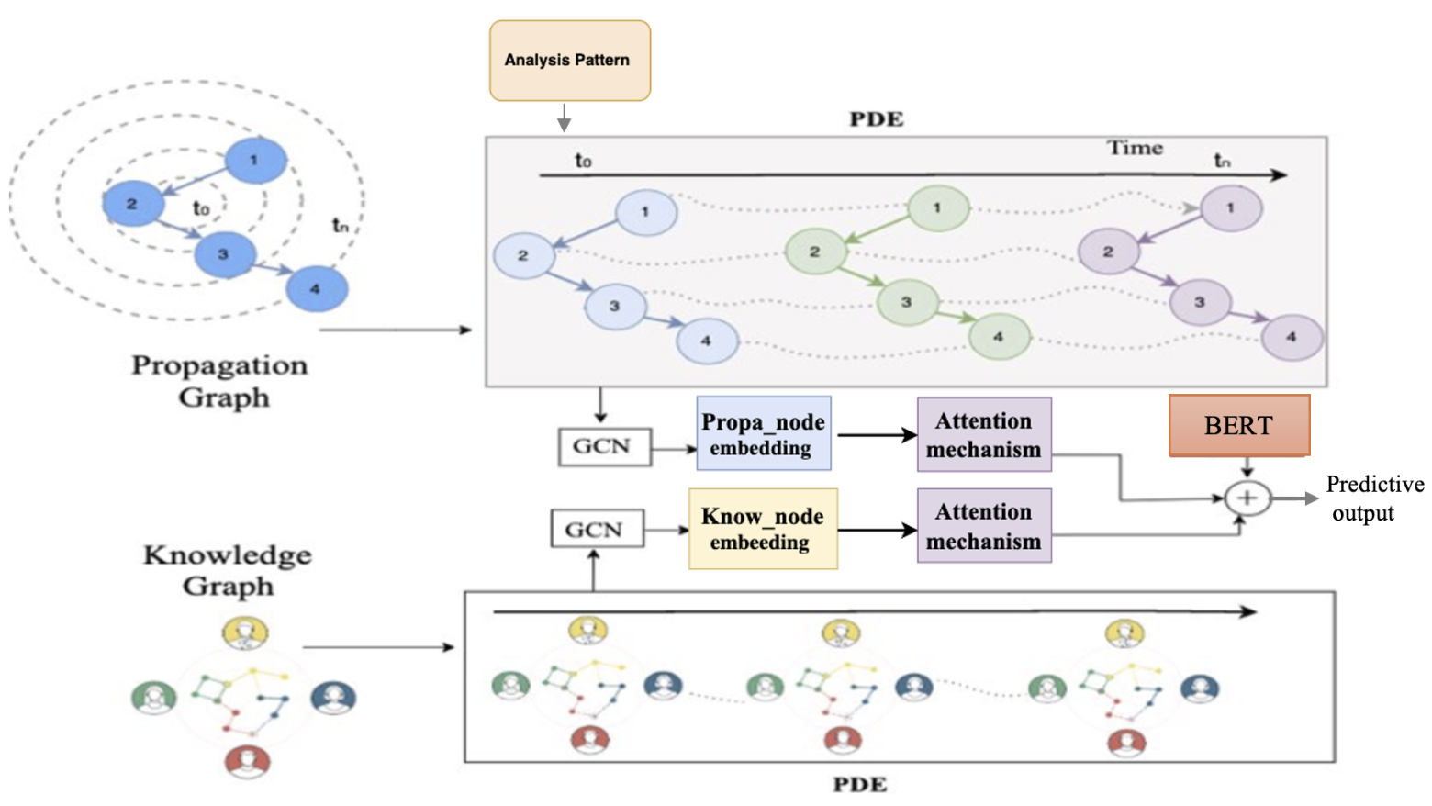
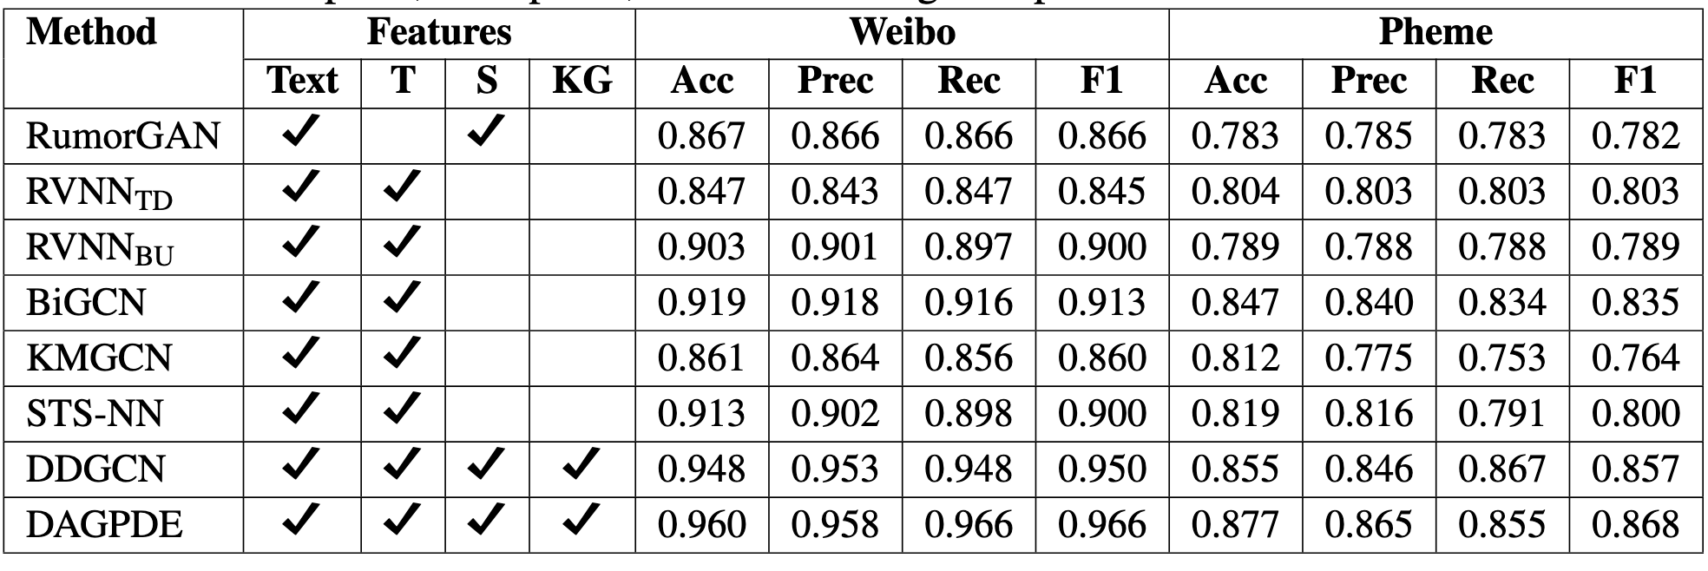
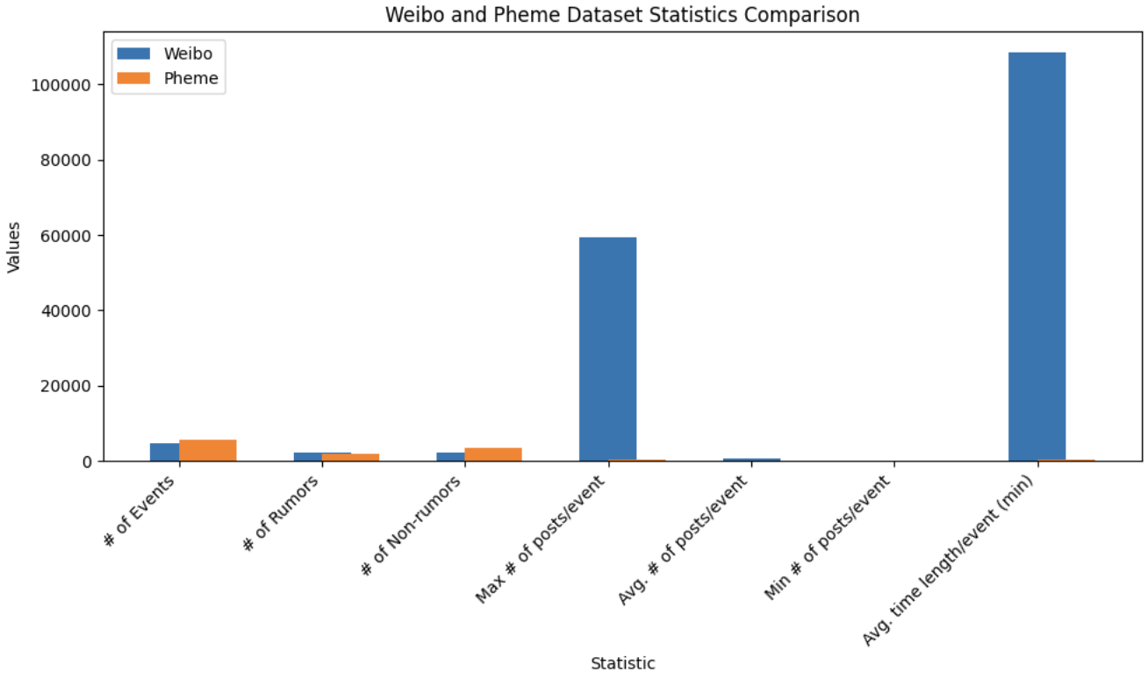
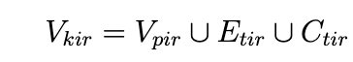
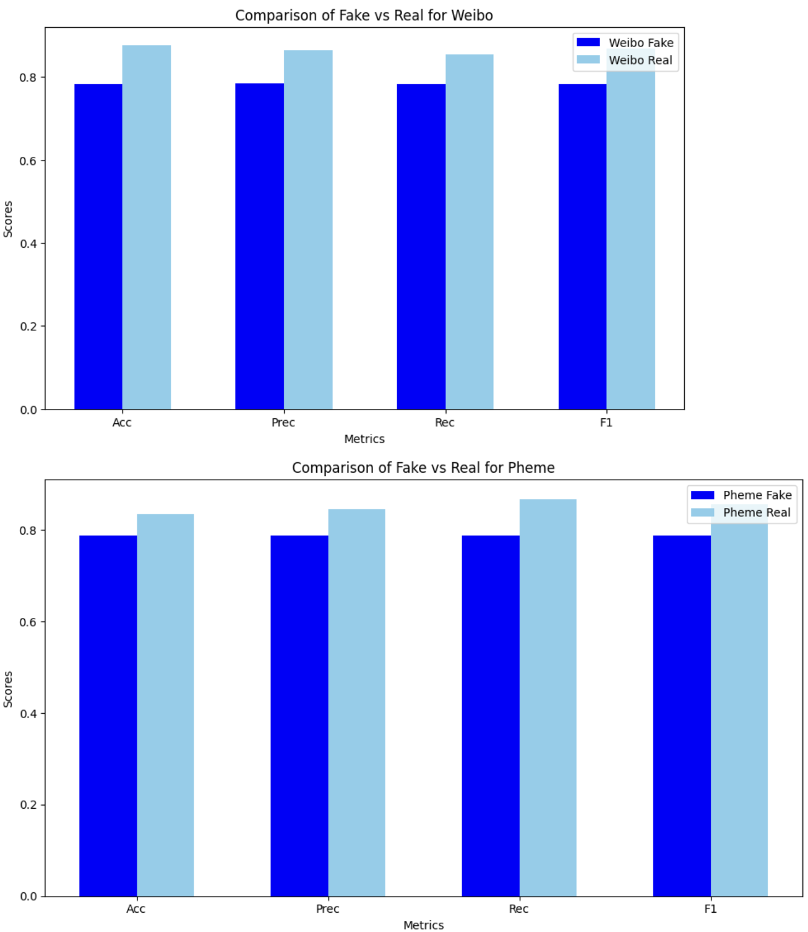
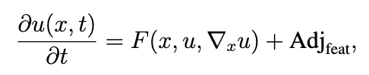
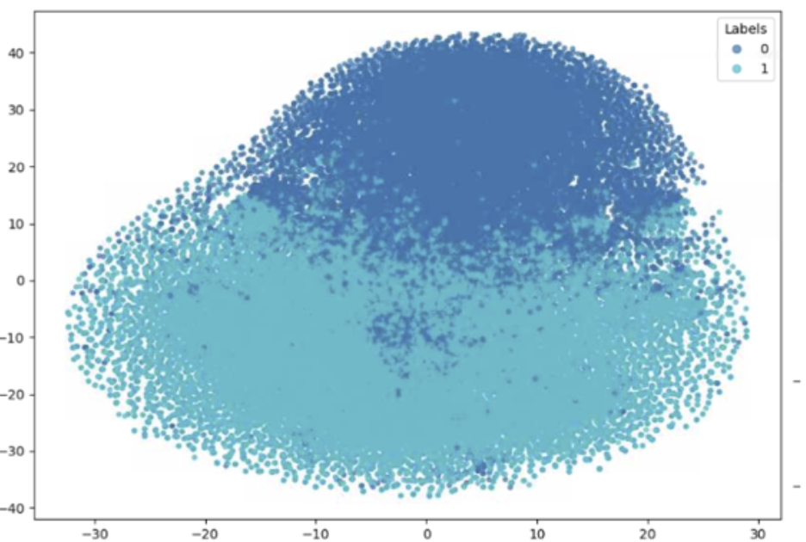
Real-Time Rumor Detection: Dynamic Graph Attention Partial Differential Equation
Ghadah Almousa
Computer Science
Introduction
most relevant parts of each graph. The attention mechanism computes attention weights between the query, key, and value matrices as follows:
The output from attention mechanism module consists of the post node and comment node representations. We employ mean-pooling operators to aggregate information
from these node representations. Then concatenate the representations from the mean-pooling operators , with the representation of the source post processed through the BERT model
Propagation graph
Discussion
The rapid spread of rumors across social media platforms presents a serious challenge to the accuracy of information and public trust. With information sprade fast and often in unpredictable ways, it becomes increasingly difficult to detect and verify the authenticity of content in real time. This is particularly problematic during crises, where false information can cause panic and prevent effective responses. However, Traditional rumor detection systems struggle to handle the dynamic and complex nature of social networks, where information is continuously evolving and spreading through various channels. To address this challenge, we propose a novel approach that incorporates dynamic graphs to track the evolution of rumors, identifying their sources and analyzing the patterns of their spread.
Problem Statement:
Detecting and managing the spread of rumors is critical for maintaining trust and ensuring the accuracy of information across digital platforms. Social media, with its vast reach and rapid dissemination of content, plays a central role in the propagation of rumors. Rumor detection involves not only identifying false or misleading content but also understanding how it spreads through the network, how its intensity changes over time, and what factors influence its propagation. The dynamic nature of this process makes it difficult to track and classify rumors accurately. As such, real-time adaptation of rumor detection systems is essential to keep pace with the evolving nature of social media.
To address this, we introduce the Dynamic Graph Attention Partial Differential Equation (DGAPDE) framework, a novel approach that models the spread of rumors in social networks over time. By integrate Graph Convolutional Networks (GCNs), Partial Differential Equations (PDEs), and Attention Mechanisms to model the temporal dynamics of rumor propagation.
Background:
(Cui et al. 2020) [1] incorporate external knowledge for better representation, yet they do not fully exploit the dynamic nature of knowledge in comments. GCNs have been used for rumor detection by modeling relationships among posts, comments, and users ( Bian et al. 2020) [2] . However, they often overlook the temporal evolution of rumors. Some models incorporate dynamic GCNs but lack knowledge integration. Our approach combines dynamic GCNs, attention mechanisms, and PDEs to capture both temporal evolution and knowledge dynamics. While existing models focus on spatial, temporal, or knowledge structures separately, our approach integrates these aspects, providing a more comprehensive solution for real-time and dynamic rumor detection.
The results presented in this research highlight the effectiveness of the (DGAPDE) model in detecting rumors in social networks. The DGAPDE framework incorporates dynamic graph construction, external knowledge integration, Partial Differential Equations (PDEs), and attention mechanisms to track and predict the spread of rumors in real time.
Our approach is its ability to model the temporal and structure evolution of rumor propagation. By utilizing PDEs, we capture the continuous nature of rumor spread, while GCNs help in understanding the structure of the social network. The incorporation of external knowledge through knowledge graphs further improves the accuracy of the model by providing richer context for the entities involved in the rumors.
In terms of dataset analysis, the comparison between Weibo and Pheme
demonstrates the diverse nature of rumor propagation. Weibo, has large number of posts per event (up to 59,318 posts), presents a more complex challenge for rumor detection compared to Pheme, which has fewer posts per event (with an average of 16 posts). Despite these differences, the DGAPDE model performs effectively on both datasets, showing that it can handle large-scale, dynamic data and accurately predict rumors.
Additionally, we observed that the maximum number of posts per event in Weibo was significantly higher than in Pheme, which points to the scale and speed at which rumors can spread on platforms like Weibo. The average time length per event also varied widely, with Weibo events lasting much longer on average (108,506 minutes) compared to Pheme events (347 minutes). This indicates the different ways in which events unfold across platforms, which can affect the detection and classification of rumors. However, while the DGAPDE model performs well in both datasets, it is important to note that rumor detection remains a challenging task, especially when considering real-time data and the evolving nature of social media. Future work should focus on enhancing the model's scalability and adaptability to even larger and more dynamic datasets, as well as improving the model’s response time for real-time detection.
Fig. 4 shows the propagation graph of a post within the Weibo dataset, demonstrating how a post spreads across the network of users over time. This graph highlights the various interactions, reposts, and replies that contribute to the spread of information on the platform. Each part of the graph gives us a deeper understanding of how content travels and gets shared among different users.
In the graph, each post is represented by a node. The color of the node reflects the type of content in the post: Purple nodes represent regular posts. Green nodes represent factual posts. Orange nodes represent emotional posts. The graph also shows edges between posts to represent interactions:
If a user reposts or replies to a post, an edge is drawn from the original post to the reposted one, visually illustrating how the post spreads through the network.
This visualization helps us track how information propagates across the platform and how it’s shared and discussed among users.
.
Architecture
Figure 1 provides a preliminary schematic overview of the model architecture and
its components. The figure 1. describe the core components of our architecture that includes: dynamic graph construction, the integration of PDEs for continuous graph updates, the application of attention mechanisms, and the, graph architecture and finally the Bert model for improved rumor detection
Fig 4. Propagation graph of a post in the Weibo dataset
Results
Table 1:
Comparison of different Methods with Features and performance on Weibo and Pheme datasets. T = Temporal, S = Spatial, KG = Knowledge Graph
Accuracy: Accuracy is a key metric for evaluating a model's overall performance. DAGPDE achieves the highest accuracy (0.960 on Weibo and 0.867 on PHEME), reflecting its ability to correctly classify rumors.
Precision: Precision (the ratio of true positives to all positives predicted by the model) is important in scenarios where false positives could have serious consequences. DAGPDE outperforms in accuracy on both datasets, indicating that it is more reliable at correctly identifying rumors.
Recall: Recall (the percentage of true positives correctly identified by the model) is particularly important for detecting all possible rumors. DAGPDE also achieves the highest recall rate, demonstrating its ability to accurately detect a larger percentage of actual rumors than other methods
Objectives
Conclusion
The main goal of this research is to create a more comprehensive and dynamic system for detecting rumors on social networks, addressing the limitations found in current methods. Specifically, the research focuses on the following objectives:
Develop a Dynamic and Real-Time Rumor Detection Framework:
Our goal is to design and implement the Dynamic Graph Attention Partial Differential Equation (DGAPDE) framework. This framework aims to capture the ever-changing patterns of rumor spread by considering both the temporal and structure aspects of rumor propagation across social networks. By combining Graph Convolutional Networks (GCNs), Attention Mechanisms, and Partial Differential Equations (PDEs), the framework will track how rumors evolve and interact in a network, while accounting for both knowledge-based relationships.
Fig 1: Architecture of DGAPDE
In conclusion, the DGAPDE model offers a promising solution for real-time rumor detection in social networks. By integrating dynamic graph-based techniques, external knowledge, attention mechanisms, and PDEs, the model can effectively capture the complex temporal and spatial dynamics of rumor propagation. The results from both the Weibo and Pheme datasets demonstrate the model’s ability to accurately detect rumors, even in large-scale and rapidly evolving data environments.
The proposed framework outperforms existing models by providing a more comprehensive approach that accounts for the evolution of information, the relationships between entities, and the contextual knowledge of the social network. As social media platforms continue to grow and rumors spread at an increasingly rapid pace, the need for effective real-time detection systems is more critical than ever. The DGAPDE model lays the foundation for future advancements in rumor detection, offering valuable insights for applications in crisis management, public health, and cybersecurity. Further improvements can be made to enhance the model’s adaptability and scalability, ensuring its effectiveness in real-world, dynamic social network environments.
Datasets
We conduct experiments on two public real-world datasets, Pheme and Weibo [3],
They are collected from Twitter and Weibo, respectively. Each event has a label, either rumor or non-rumor. The datasets contain rich information, including post texts, user comments, and their release times. Fig. 2 shows the statistics of the datasets
Fig 2 highlights the distinct patterns of rumor propagation, emphasizing the challenges posed by Weibo’s multimodal content and event-specific nature.
Methodology
The model integrates Graph Convolutional Networks (GCNs), Partial Differential Equations (PDEs), and Attention Mechanisms to capture the complex dynamics of rumor propagation over time. Below is a summary of the methodology, including key equations:
1. Dynamic Propagation Graph Construction
For each event Ei, we construct a sequence of propagation graphs over time, where the propagation graph at the r-th time stage is represented as:
At each time stage, the adjacency matrix of the propagation graph is updated to reflect changes in the graph structure over time.
2. Dynamic Knowledge Graph Construction
We create a knowledge graph that evolves with the event, capturing the knowledge extracted from both the source post and its comments
3. Partial Differential Equations (PDEs)
To model the continuous evolution of rumor intensity over time, we use the following PDE:
where:
• u(x, t): The state of the rumor x and time t, representing the intensity or likelihood
of a rumor being present at a specific node (post or comment) in the network.
• ∇xu: The gradients capturing localized variations in the spread of the rumor. These
gradients represent the difference in rumor intensity between connected nodes (posts
or comments).
• F (x, u, ∇xu): The evolution function modeling the temporal interactions of rumor
propagation. This function determines how rumors evolve over time and spread
across connected nodes based on their current state and neighborhood interactions.
The adjacency matrix Adj ensures that the propagation model
is consistent with the social network structure, reflecting how information spreads across the graph.
4. Dual-Dynamic GCN Module
The Dual Dynamic GCN Module is composed of two GCN units one for encoding
the propagation graph and another for the knowledge graph and a temporal fusion unit. The module processes both graphs sequentially at each time stage r, updating the node features as the event evolves.
5. Attention Mechanisms for Feature Importance
To emphasize important features in both the propagation and knowledge graphs,
we incorporate Attention Mechanisms. Multi-head attention is applied to focus on the
Future Work
Explore multi-view learning for deeper insights into rumor propagation.
Further integrate temporal patterns for better adaptability in rapidly changing social networks.
Fig 2: Datasets Statistic
Acknowledgment
I Would like to express my sincere gratitude to my advisor, Yugyung Lee , for her invaluable guidance and support throughout this research.
Reference
[1]. Zhang, Q. Fang, S. Qian, and C. Xu, “Multi-modal knowledge-aware event mem-
ory network for social media rumor detection,” in Proceedings of the 27th ACM
international conference on multimedia, 2019, pp. 1942–1951.
[2]. Bian, X. Xiao, T. Xu, P. Zhao, W. Huang, Y. Rong, and J. Huang, “Rumor de-
tection on social media with bi-directional graph convolutional networks,” in Pro-
ceedings of the AAAI conference on artificial intelligence, vol. 34, no. 01, 2020, pp.
549–556.
[3] M. Sun, X. Zhang, J. Zheng, and G. Ma, “Ddgcn: Dual dynamic graph convolu-
tional networks for rumor detection on social media,” in Proceedings of the AAAI
conference on artificial intelligence, vol. 36, no. 4, 2022, pp. 4611–4619
Fig 3: t-SNE visualization of rumor categories in Weibo.

